Slide 1



IPL WINNING PREDICTION MODEL
SUBMITTED TO :
DR. NIDHI GUPTA
PRESENTED BY:
PRANITA BHOSALE (21MMA022)
VISHAL MOHAN (21MMA012)
SOUMYAJIT GHOSH (21MMA004)

Slide 2
INTRODUCTION
In this project we made a predictor model that trains on the IPL dataset and gives us prediction about winning a particular match by a team based upon some previous datapoints .
Based upon training by different models it also tells us which machine learning model is better to use by checking accuracy resulting minimum possible error .
We also tried to show while using Logistic regression, Random-Forest, K-nearest neighborhood on which range of values of K (or, number of estimators --> number of trees ) the model provides better accuracy .

Slide 3
OBJECTIVES
Understand basic Machine learning algorithms and applying them into real-life problems like prediction ,classification, segmentation, image-processing etc .
Application of Regression techniques like linear, multiple ,logistic as required in case .
In case of regression ,plotting the best-fit line for which residual is minimum .
How to do efficient data pre-processing .
Understand how to do Feature-selection based upon preconditions.
To do Exploratory Data Analysis (EDA)
Understanding when to use which plot of various types of graphs
To change categorical variable into numerical .
To understand what causes model to have underfitting and overfitting and for removing this issue how we can use Regularization .
Calculate different kinds of errors of model .

Slide 4
CONCEPTS USED
Basic python libraries such as NumPy, Matplotlib, Pandas, Seaborn.
Feature selection
Descriptive statistics for knowing statistical measures of dataset.
Missing-value checking and use of Imputing .
Encoding techniques for nominal encoding – OneHotEncoding .
Column transformation
Pipeline
Correlation checking between certain features using Spearman rank , Karl-Pearson .
Plotting of heatmap, distribution plot(P.D.F),bar plot, scatter plot .
Train-test-split function to randomly partition entire dataset into training and testing part .
Various in-built ML models such as – logistic regression, Random Forest .

Slide 5
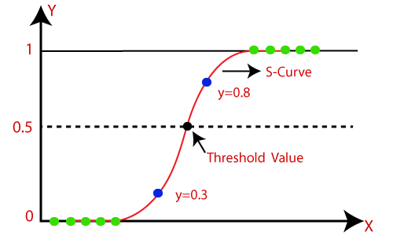
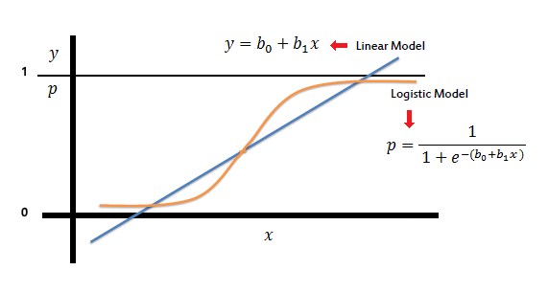
METHODS DESCRIPTION
Logistic Regression : This is one of the most widely used regression algorithms. It is simple and more efficient than linear regression . It is mostly popular for binary classification problems like “yes or no”, ”may have or may not have any disease “,”winning or losing in a match” . Basically Logistic regression is nothing but a transformation or function that maps entire datapoints into [0,1] . Graphically it forms a sigmoid (S-type) curve . Generally by default it has threshold value of 0.5 which means crossing it every point is to be labelled as 1’s or for rest are 0’s. But we can change that threshold value in case of other problem in need . The parameters of logistic regression are found out by Maximum-likelihood-estimation (MLE) .

Slide 6
Random-Forest :
It is an example of ensemble learning methods which uses multiple learning algorithms to give better prediction values . More precisely random-forest is a Bootstrap aggregation or Bagging method .In easy way it is nothing but collection of multiple decision trees working together parallelly . As we know in general decision trees there is overfitting or low bias and high variance → low train error but high testing error so bad performance in testing dataset , but after this parallel arrangement this high variance converts into low variance . Basically random-forest divides entire dataset into smaller parts and gives to each trees and after training in each trees it collects the majority result . And we can also change its accuracy by controlling the number of estimators .
Exploratory Data Analysis : EDA is just the beginning of understanding of data . To know their internal relation we find descriptive statistics by describe() ,to know how much memory they take we use info() . To visualize their dynamics we also use various kins of plots Eg. Distplot, Pairplot, catplot …etc.

Slide 7
Data Preprocessing :
After loading of dataset and a thorough basic understanding of data , the one of the most important part of machine learning is to make beautiful data from raw datapoints by cleaning . It is costly and time consuming also . Since in real-life scenario we always get dirty unorganized data ,then to reform it and make some fruitful intuition from it by extracting valid information's we need to do certain things which are as follows :
a) Missing-values handling
b) Outlier analysis
c) Encoding
d) Feature-selection
e) Cross-validation and many more .
Out of all point d) may seem a little too trivial but it has immense importance because in real-time there are tons of features and if we don’t decide which to keep and which to delete ,then it would reflect negative impact in accuracy .

Slide 8
Missing-points handling :
Missing values tells a lot about dataset .To detect its location we use isnull().
But to get numbers of these feature wise we may use is null().sum() . Afterall
to replace the vacant places with some values we uses a library named “Simple Imputer() “ .It has multiple ways to complete those spaces by any
statistical means .
OneHotEncoding :
It is type of encoding techniques that used to change categorical variable
into numerical variable . More precisely OneHotEncoding is a nominal
categorical encoding techniques . It is used as mostly ml models can’t train
dataset with categorical/string variable .

Slide 9
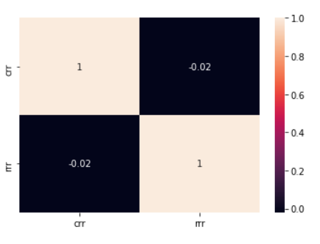
Correlation :
We use Spearman correlation rank and Karl-pearson rank correlation to observe how closely two features are correlated or even uncorrelated . We know correlation coefficient (ρ) belongs [-1,1] . Here is a heatmap showing “negative correlation” between “crr” and “rrr” .
Pipeline :
A machine learning pipeline is a way to codify and
automate the workflow ,it takes to produce a machine
learning model . It consists of multiple sequential steps that
do everything from data extraction to pre-processing to
model training and deployment .

Slide 10
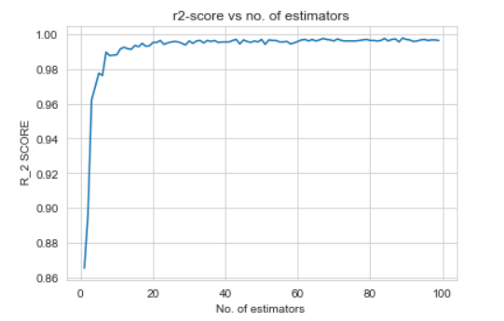
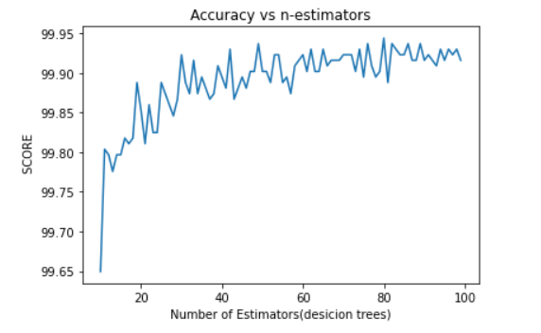
RESULT
Increasing no of decision trees amount of error almost tends to 0
Increasing number of decision trees accuracy score is quite fluctuating

Slide 11
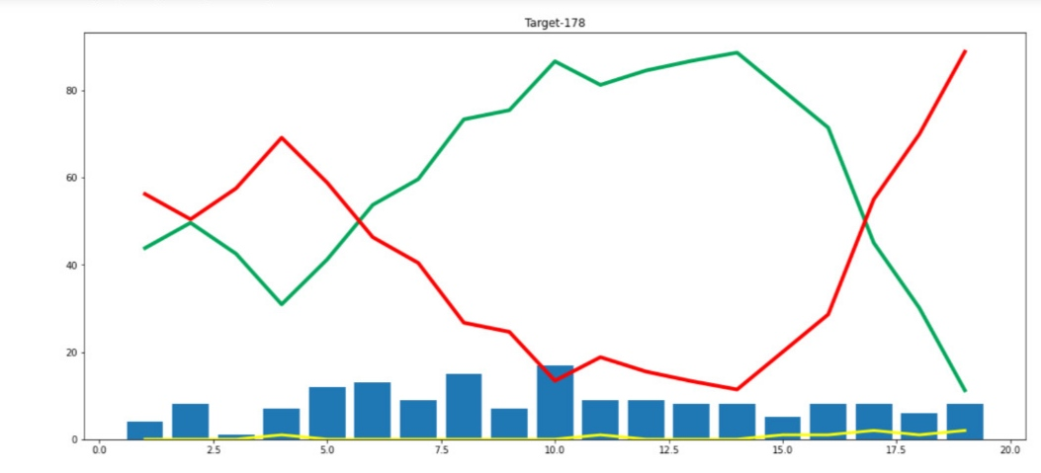
OUTPUT

Slide 12
ACKNOWLEDGEMENT
We would like to thank our teacher, Dr. Nidhi Gupta who gave us this opportunity to work on this project. We got to learn a lot from this project about various concepts of how machine learning model works on real-life dataset .
During the making of project we’ve consulted following book:
Pattern Classification by Richard O. Duda ,Peter E hart ,David G. Stork
The elements of Statistical learning -- Friedman, Hastie, Tibshirani .
We also took help from various blogs and YouTube videos .

Slide 13
THANK YOU

